Slide 1
Cyclistic Bike-Share Analysis
Jennifer Osterman
Cyclistic Case Study | Data Analysis Project

Slide 2
Business Problem
Cyclistic aims to increase annual memberships by converting casual riders into members.
This analysis explores behavioral differences between rider types to inform targeted marketing strategies.

Slide 3
Data Overview
Data sourced from Divvy bike-share system
Time period: Q1 2019 and Q1 2020
Over 700,000 ride records analyzed
Key variables:
Rider type (casual vs member)
Ride length
Day of week

Slide 4
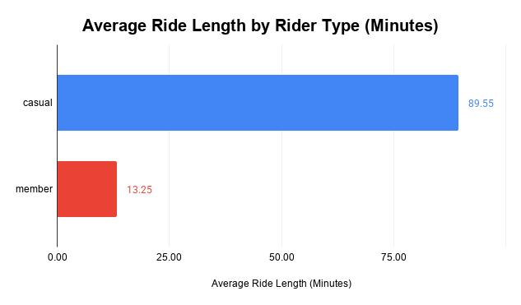
Average Ride Length by Rider Type
Casual riders take significantly longer rides than members.
On average:
Casual riders: ~90 minutes
Members: ~13 minutes
This suggests casual riders primarily use bikes for leisure, while members use them for shorter, routine trips.
Casual rides are nearly 7x longer than member rides.

Slide 5
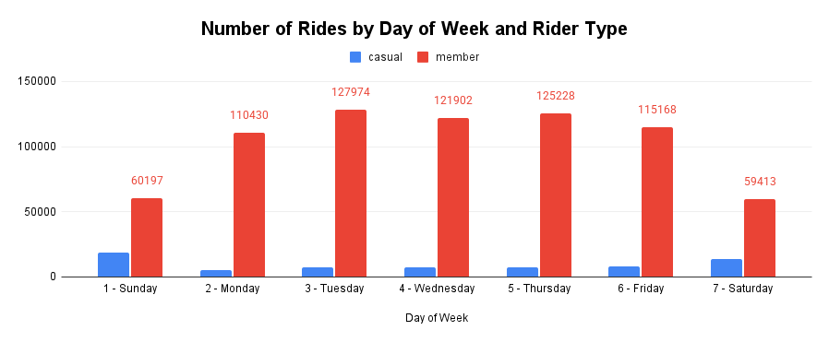
Number of Rides by Day of Week
Members ride significantly more frequently, especially on weekdays, indicating consistent commuting behavior.
Casual riders show increased activity on weekends, indicating more recreational usage patterns.

Slide 6
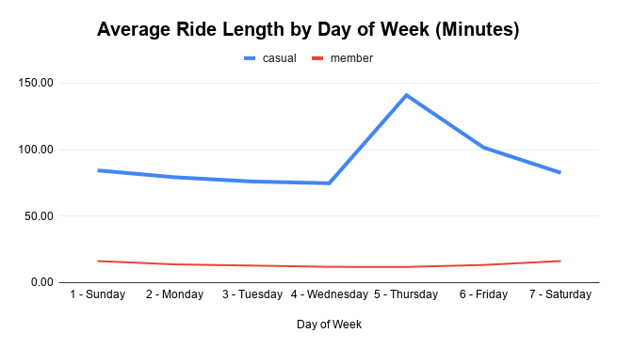
Average Ride Length by Day of Week
Casual riders consistently take longer rides across all days of the week.
A noticeable spike in ride length occurs on Thursday, which may be influenced by unusually long rides or outliers.

Slide 7
Key Insights
Casual riders take longer, less frequent rides
Members take shorter, more frequent rides
Casual riders are more active on weekends
Members show consistent weekday usage

Slide 8
Recommendations
Offer weekend promotions to attract casual riders
Introduce trial memberships to encourage conversion
Develop marketing campaigns targeting leisure riders
Focus efforts in high-traffic and tourist-heavy areas

Slide 9
Conclusion
By understanding how casual riders differ from members, Cyclistic can implement targeted strategies to increase membership conversions.
These insights provide Cyclistic with a data-driven foundation to improve customer conversion and long-term retention.

Slide 10
Data Source
Divvy Bike Share Dataset
Provided by Motivate International Inc.
https://divvy-tripdata.s3.amazonaws.com/index.html
This analysis was completed as part of the Google Data Analytics Certificate.
Data has been cleaned and transformed for analysis.

